Slide 1
03 | Building a Backend with Socket.IO and Mongo
Stacey Mulcahy | Technical Evangelist
Rami Sayar | Technical Evangelist

Slide 2
Module Overview
What are Web Sockets?
Using Socket.IO to connect users, broadcast and receive messages
Using Mongo to save messages and emit last received messages.

Slide 3
03 | What are Web Sockets?
Stacey Mulcahy | Technical Evangelist
Rami Sayar | Technical Evangelist

Slide 4
What are Web Sockets
A Websocket is a protocol designed to allow web applications to create a full-duplex channel over TCP (i.e. to have bi-directional communication) between the web browser and a web server.
It is fully compatible with HTTP and uses TCP port number 80.
WebSockets allowed web applications to become real-time and support advanced interactions between the client and the server.
It is supposed by several browsers including Internet Explorer, Google Chrome, Firefox, Safari and Opera.

Slide 5
What is Socket.IO
Socket.IO is a simple JavaScript library and node.js module that allows you to create real-time bidirectional event-based communication apps simply and quickly.
It simplifies the process of using WebSockets significantly. We will be using Socket.IO v1.0 to make our chatroom app.

Slide 6
03 | Implementing Socket.IO to connect, send and receive messages
Stacey Mulcahy | Technical Evangelist
Rami Sayar | Technical Evangelist

Slide 7
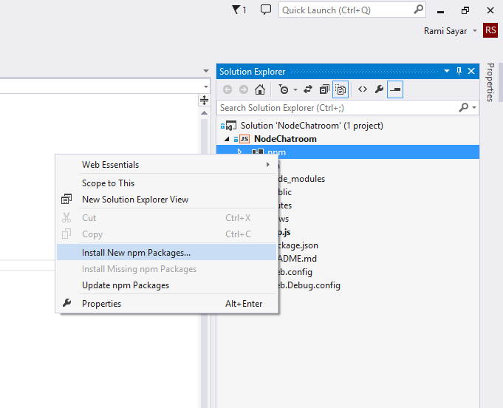
Implementing Socket.IO
Add it to the package.json
In Visual Studio > right click NPM to add module
OR:
npm install --save socket.io

Slide 8
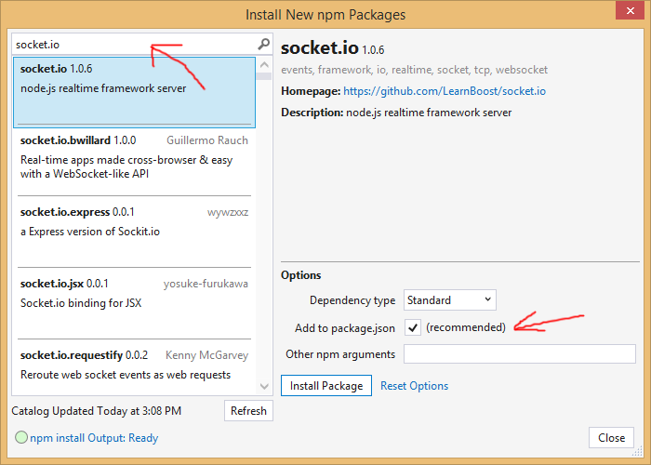
Implementing Socket.IO

Slide 9
Using Socket I.O to connect users, send and receive messages

Slide 10
03 | Using a NoSQL Database
Stacey Mulcahy | Technical Evangelist
Rami Sayar | Technical Evangelist

Slide 11
About NoSQL databases
Not only SQL
Different types: document based, graph databases etc.
MongoDB, Couchbase, HBase, Cassandra
Object oriented APIs
Good for large amounts of data, can be scaled

Slide 12
Using MongoDB
Need to create a mongodb
3rd party sources like MongoHQ or MongoLab
Use the MongoLab add on in Azure
Can customize and manually use via VM
Need the mongodb URI for connection

Slide 13
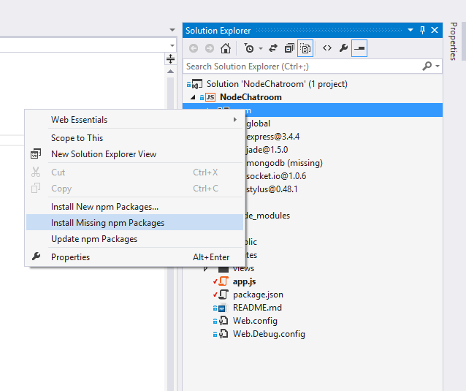
Add Support for MongoDB
Modify package.json : "mongodb": "^1.4.10",
Right click NPM in Visual Studio > right click to install dependencies

Slide 14
Saving messages to Mongo and emitting the last 10 messages received.

Slide 15
Setting environment variables

